Slide 1
Infographics: the basics
Maria Nuccilli
Graduate Student, School of Library and Information Science
Wayne State University, Detroit, MI
mnuccilli@wayne.edu

Slide 2
What are infographics?

Slide 3
“Simply put, an infographic uses visual cues to communicate information.”
(Lankow, Crooks & Ritchie, p. 20, 2012)

Slide 4
Information + graphics
Combine textual, graphic and quantitative information to tell a story
Quickly introduce a topic
Easily interpretable
Reveal insights that could otherwise disappear

Slide 5
Information + graphics
Memorable
Ideal for online communication
Shareable on social media
Easily utilized for posters, signage, etc.

Slide 6
Telling a story visually
Charts & graphs
Maps
Timelines
Venn diagrams
Graphics
Lists
Flowcharts
Data visualizations
Interactive dashboards
… and much more!

Slide 7
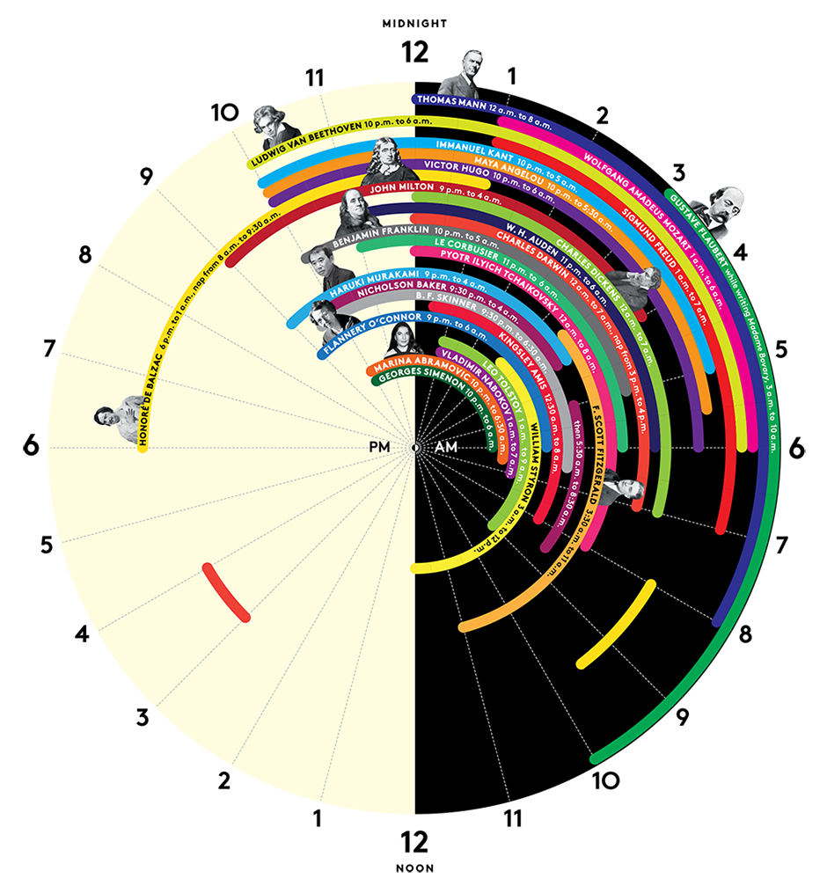
An infographic can be as complex as this ...
Source: http://nymag.com/health/bestdoctors/2014/genius-sleeping-habits-2014-6/

Slide 8

… or as simple as this!
Source: https://pixabay.com/en/share-the-road-sign-bike-automobile-1894934/

Slide 9
History of infographics
The visual representation of complex information isn’t a new idea
Cave paintings, map making
More recent historical examples:
1856: Florence Nightingale’s visualization of military mortality
1869: Charles Joseph Minard’s visualization of Napoleon's Russian campaign of 1812
(Lankow, Crooks & Ritchie, 2012)

Slide 10
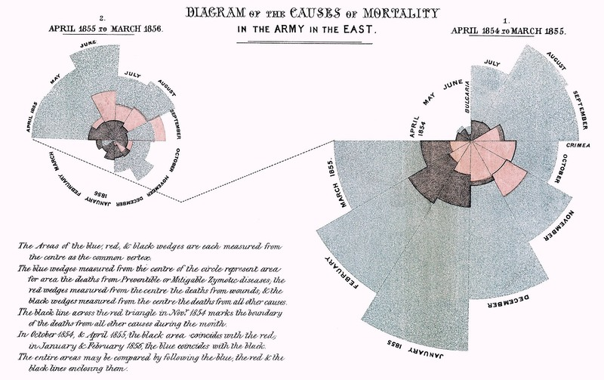

Slide 11


Slide 12
Why do infographics work?

Slide 13
“Seeing comes before words.
The child looks and recognizes before it can speak”.
John Berger, Ways of Seeing
(p. 7, 1977)

Slide 14
Issues affecting retention
Time constraints
Short attention spans
Information overload

Slide 15
Humans are visual learners
Visual communication is a powerful way to deliver a message
Visual processing – the brain can process visuals far quicker than text
(Crane, p. 5)

Slide 16
10%
Studies suggest humans retain 10% of information when just listening to somebody speak ...

Slide 17
20%
… and retain 20% of information when reading.

Slide 18
+80%
When images are used in combination with a data set, information retention can increase up to 80%
(Cadleigh, 2015)

Slide 19
How can infographics be used?

Slide 20
"Infographics can play a powerful part in any library's twenty-first-century game plan.”
Beverly Crane, Infographics: A Practical Guide for Librarians
(p. xvi, 2016)

Slide 21
How to use infographics
Sharing research
Marketing library resources
Highlighting accomplishments
Advocacy / Outreach materials
Teaching information literacy

Slide 22
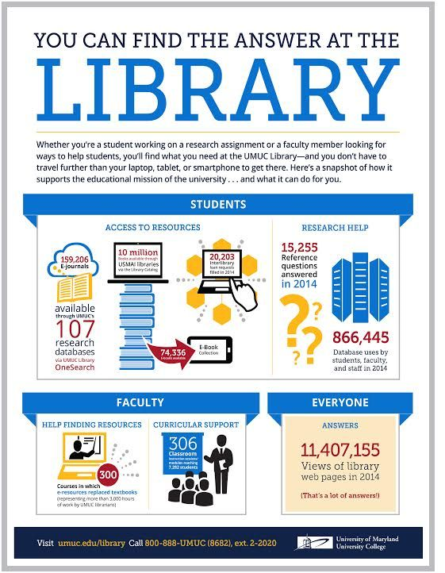
Source: https://sites.umuc.edu/library/libabout/

Slide 23
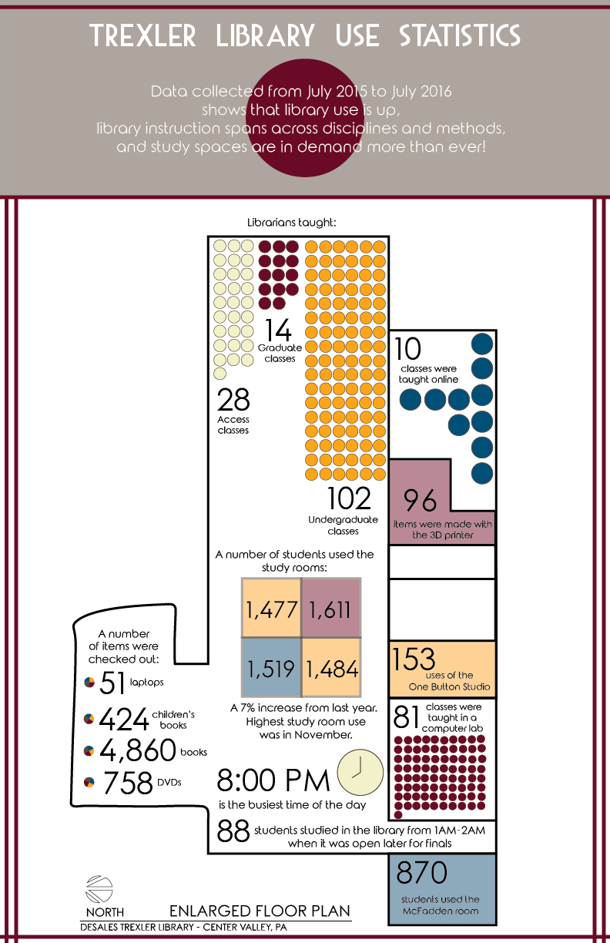
Source: https://librariandesignshare.org/2017/05/09/illustrating-library-usage/

Slide 24

Source: https://librariandesignshare.org/2016/07/13/quick-fixes/ill-details-ad/

Slide 25
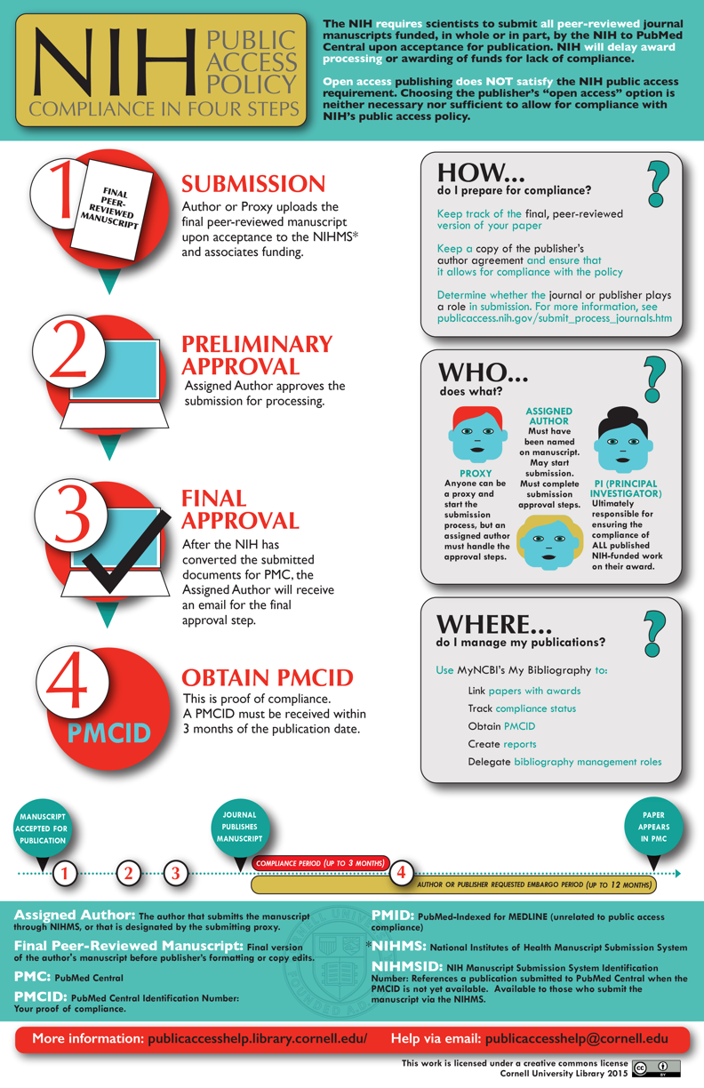
Source: https://librariandesignshare.org/2015/12/10/nih-compliance-in-four-steps/

Slide 26
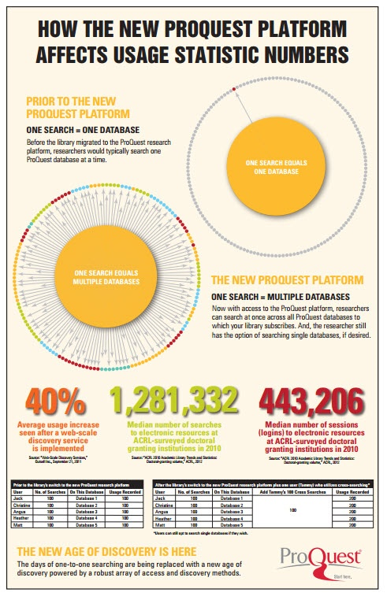
Source: https://www.pinterest.com/pin/366621225886073656

Slide 27
References
Berger, J. (1977). Ways of seeing. London: British Broadcasting Corp.
Crane, B. E. (2016). Infographics: A practical guide for librarians. Lanham, MD: Rowman & Littlefield.
Caidleigh, M. (2015, March 25). Visual Communication: A Powerful Tool. Retrieved from https://blog.lucid.berlin/2015/visual-communication-a-powerful-tool/
Lankow, J., Crooks, R., & Ritchie, J. (2012). Infographics : The Power of Visual Storytelling. Hoboken, NJ: John Wiley & Sons, Incorporated.

